Slide 1
How Much is a Policyholder Worth?
Christian Palisoc

Slide 2
What Factors are we Considering?
State
Coverage
Education
Employment
Gender
Income
Location
Marital Status
Number of policies
Policy type
Renewal offer type
Sales Channel
Vehicle Class
Vehicle Size
Total time insured
Monthly premium

Slide 3
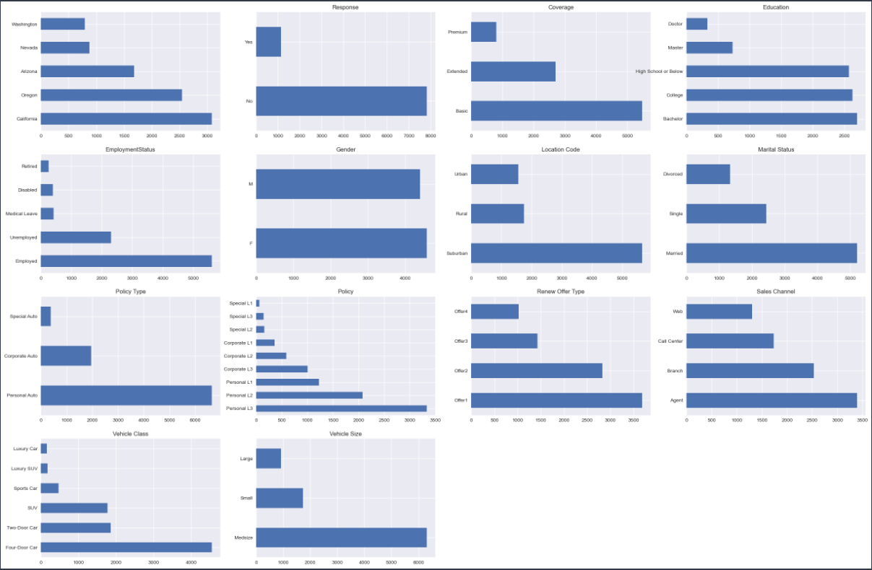
Distribution of Data

Slide 4
Tuned Random Forest Model
Results
Mean Absolute Error: $1,535.88
Mean Squared Error: $14,860,484
R-Squared Score: 67.47%

Slide 5
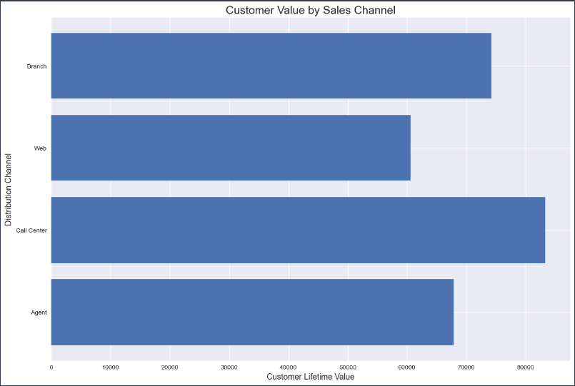
Recommendations

